Slide 1
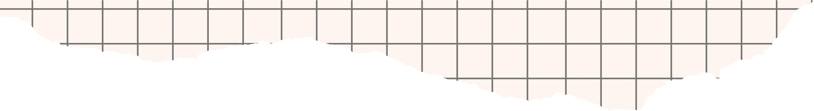




SPOTIFY
PROJECT
By Jeya Raman Sekar
By Olivia Wilson

Slide 2



TODAY'S AGENDA
Introduction
Problem Statement
Features
Objectives
Business Model
Results
Project overview
Recommendations

Slide 3



INTRODUCTION
Launched in 2008, Spotify is a leading digital music streaming service that provides users access to millions of songs, podcasts, and videos from artists all around the world.

Slide 4

Key Features
Music Library
Podcasts
Playlists
Personalization
Social Features
Cross-Platform Access

Slide 5
Business Model
Free Tiers
Premium Tier

Slide 6
PROJECT
OVERVIEW
This project aims to leverage Tableau's powerful visualization capabilities to transform raw Spotify data into meaningful and interactive visualizations. These visualizations will enable users to gain insights, make data-driven decisions, and explore their music preferences in a visually engaging manner.

Slide 7

OBJECTIVES
OBJECTIVE 1
OBJECTIVE 2
User Insights - Users can easily explore their music preferences and discover new trends in their listening habits.
Enhance Engagement - Based on analysis, improve enhancements and engagements.
Data Driven Decision Making - Artists, marketers, and industry professionals can make informed decisions based on the insights gained from the visualizations.

Slide 8
PROJECT
APPROACH
Data Cleaning & Preparation
Exploratory Data Analysis (EDA)
Data Visualizations
Dashboard Creation
Recommendations

Slide 9
DATA
CLEANING
I began by downloading the raw Spotify data in CSV format, converting it to an Excel file for easier manipulation. I removed null, duplicate, and blank values to ensure data integrity and standardized date formats for consistency across the dataset. To facilitate analysis, I structured the data into five different sheets: Track Sheet, Artist Sheet, Streams Sheet, Position Sheet, and Country Sheet. This cleaned and organized data is now ready for insightful analysis and visualization in Tableau.

Slide 10
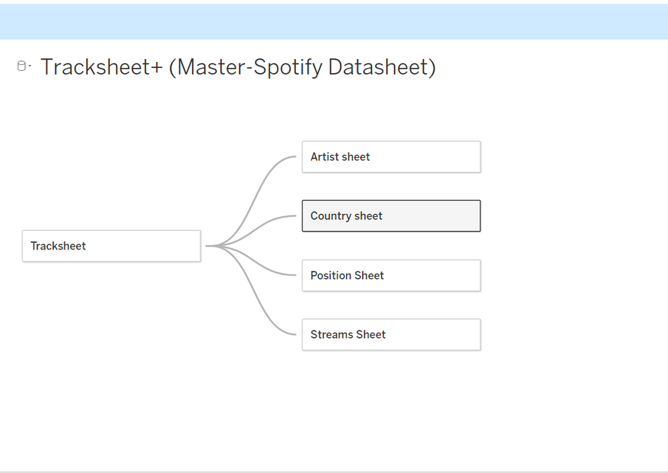
DATA
MODELLING
After cleaning and organizing the data, I uploaded the master Spotify dataset into Tableau and created relationships between the sheets to enable comprehensive and interactive analysis.

Slide 11






DATA VISUALIZATION

Slide 12
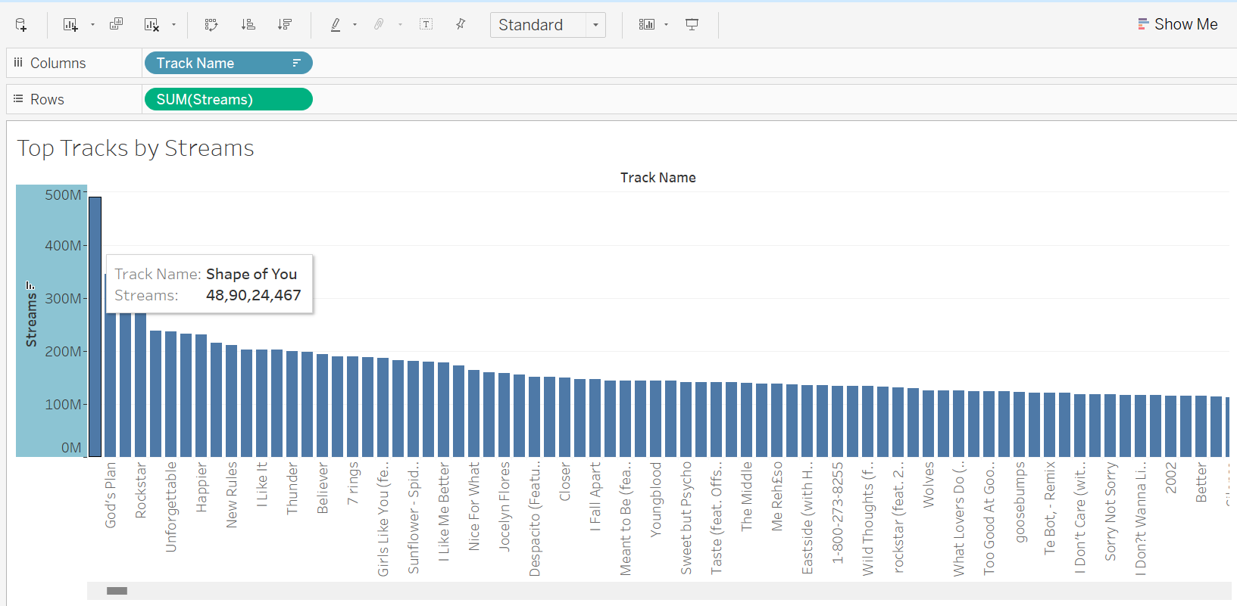

Top Tracks
The "Top Tracks by Streams" bar chart is a powerful visualization for identifying and understanding the most popular tracks on Spotify. It provides valuable insights into listener preferences and trends, aiding in data-driven decision-making for marketing and promotional strategies.

Slide 13
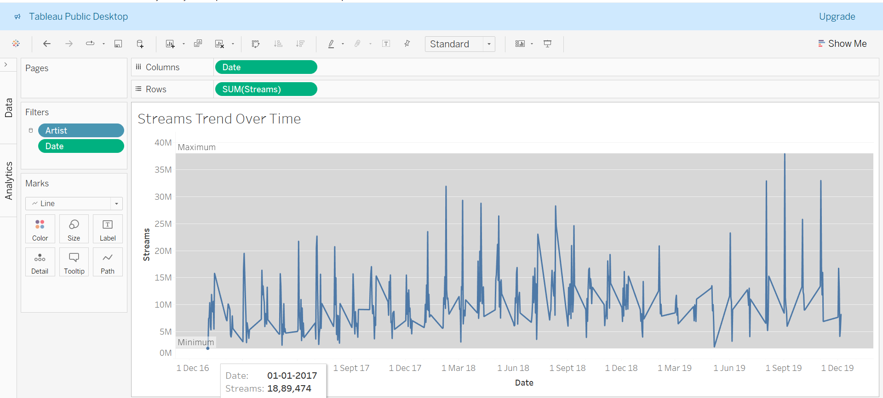
Streams Trends
The "Streams Trend Over Time" line chart is a powerful tool for understanding how streaming activity evolves. It offers valuable insights into listener behavior and can inform strategic decisions related to content release and promotion.

Slide 14

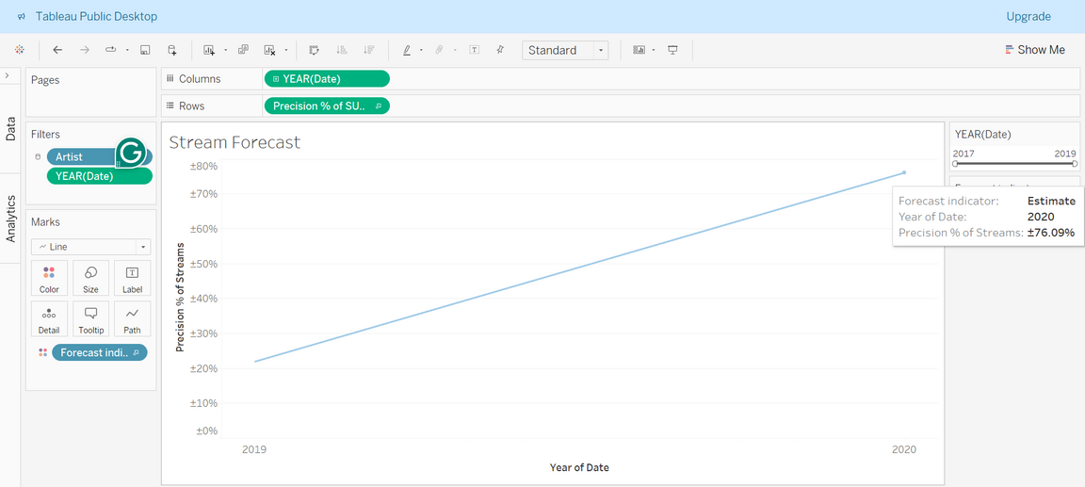
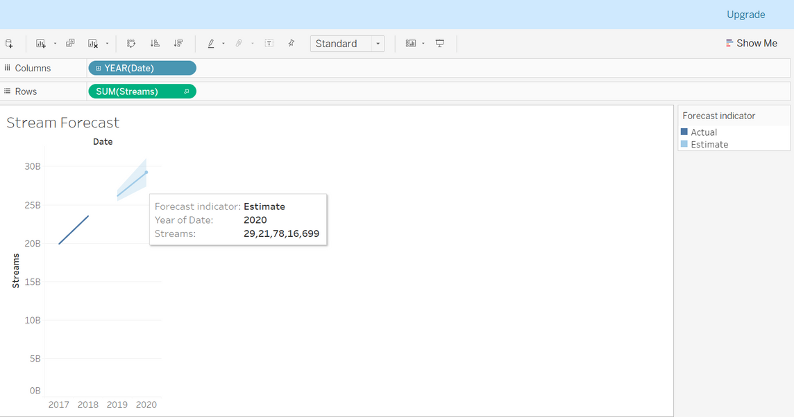
STREAMS FORECAST
This visualization aims to predict future streaming trends based on historical data, providing valuable insights for planning and strategy.
Forecasting helps in anticipating future demand, optimizing marketing efforts, and making data-driven decisions.

Slide 15
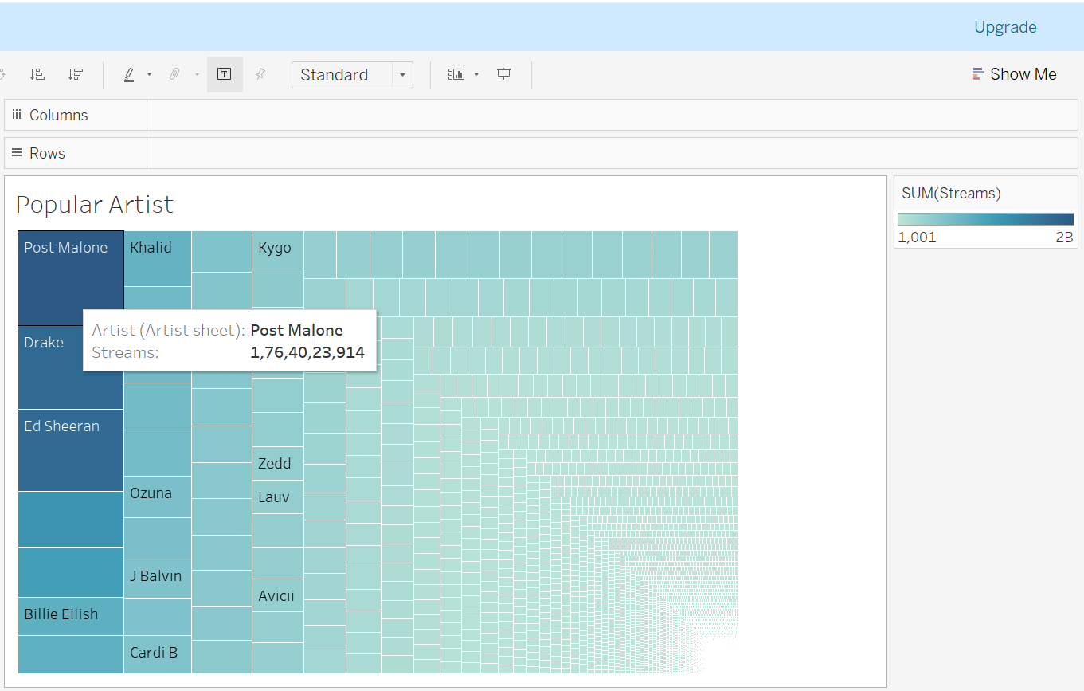
POPULAR ARTIST
This visualization identifies and highlights the most popular artists on Spotify based on various metrics such as streams, popularity scores, or listener counts.
Understanding popular artists helps in recognizing current music trends and making informed decisions for promotions and collaborations.

Slide 16
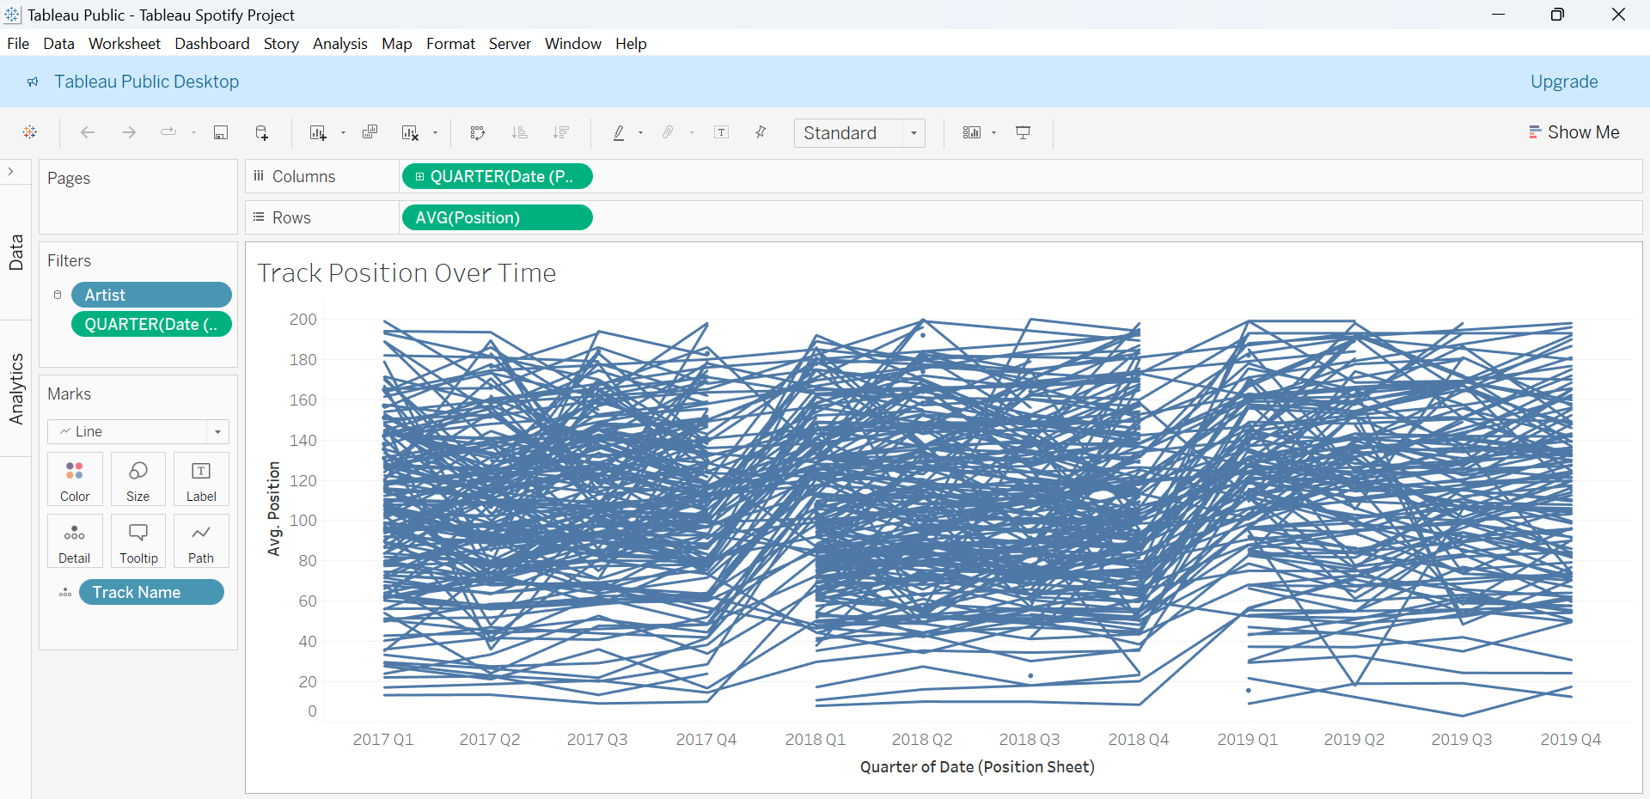
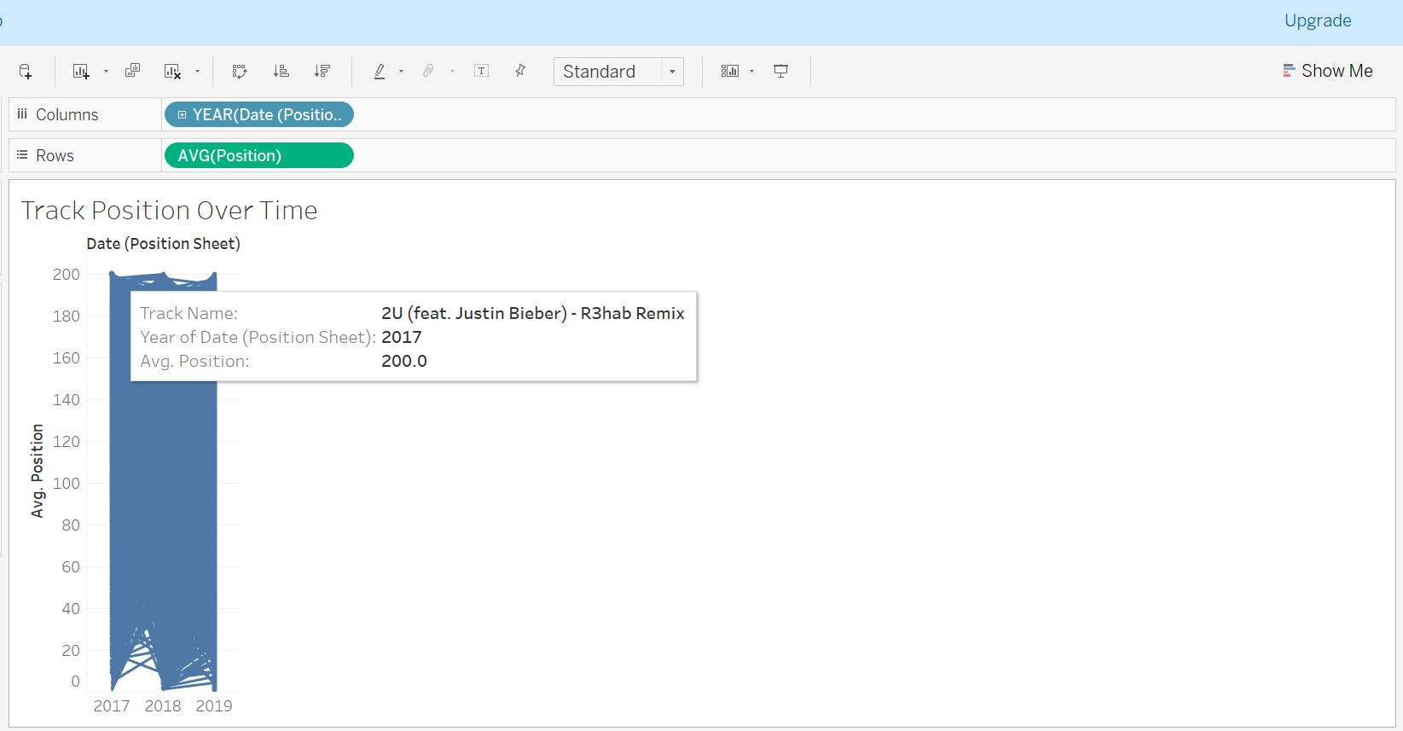
TRACK POSITION
To provide a detailed view of our position trends, we’ve included two images: one showing quarter-wise average positions and the other displaying year-wise averages.
This granularity helps us identify seasonal patterns or specific periods where our strategy had a marked impact

Slide 17
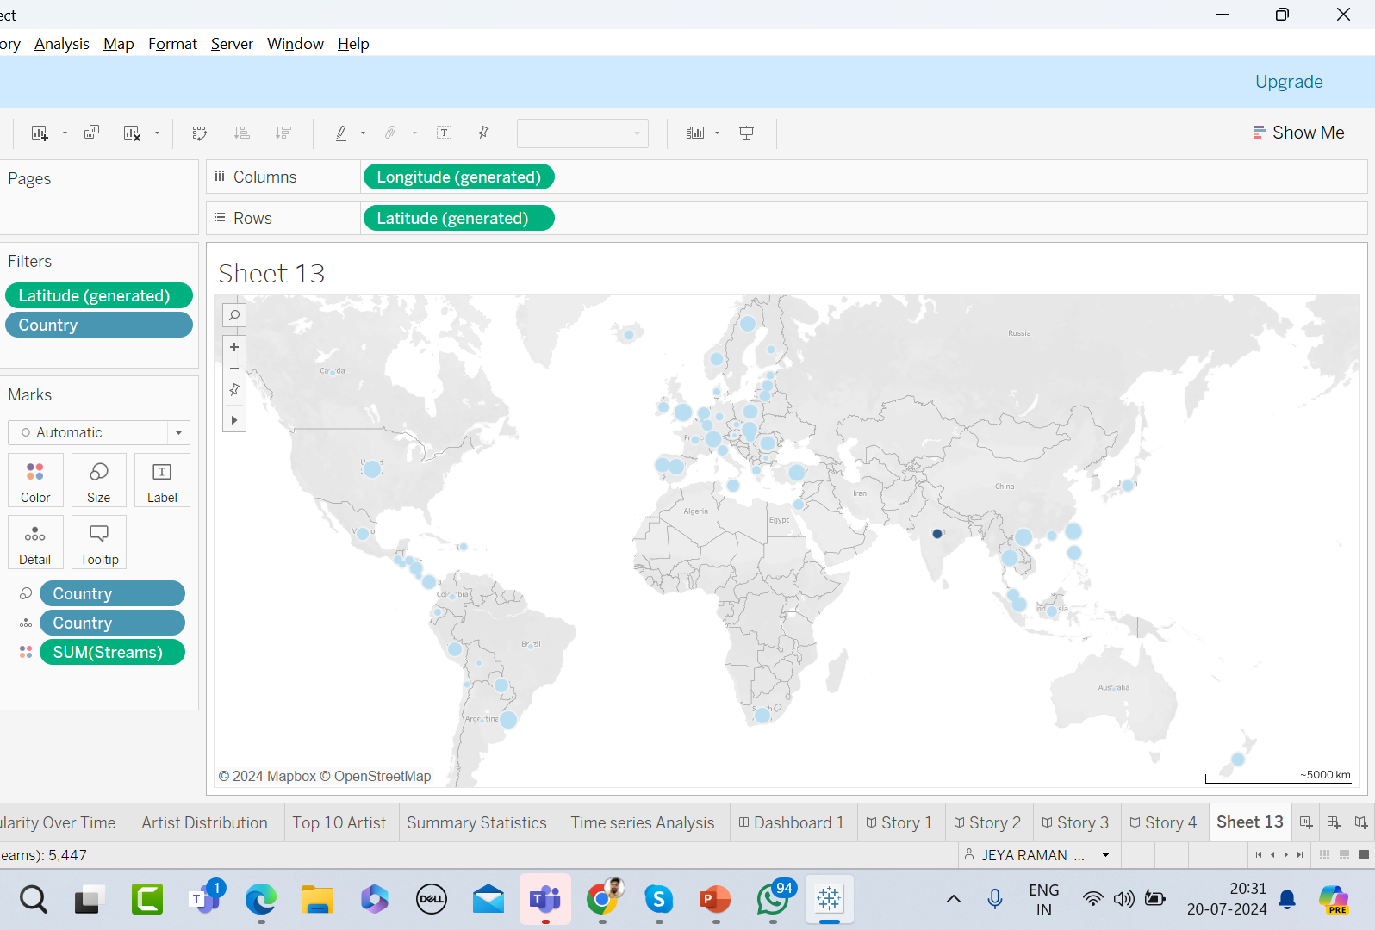
MAP VISUALS
The map clearly shows country-wise streams

Slide 18
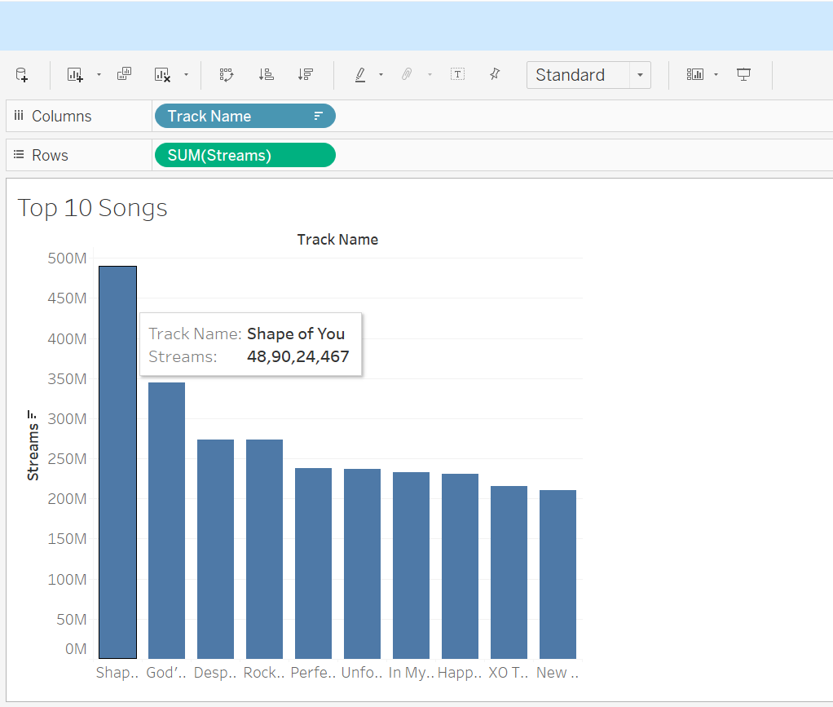
TOP 10 SONGS
TOP 10 SONGS WITH STREAMS

Slide 19
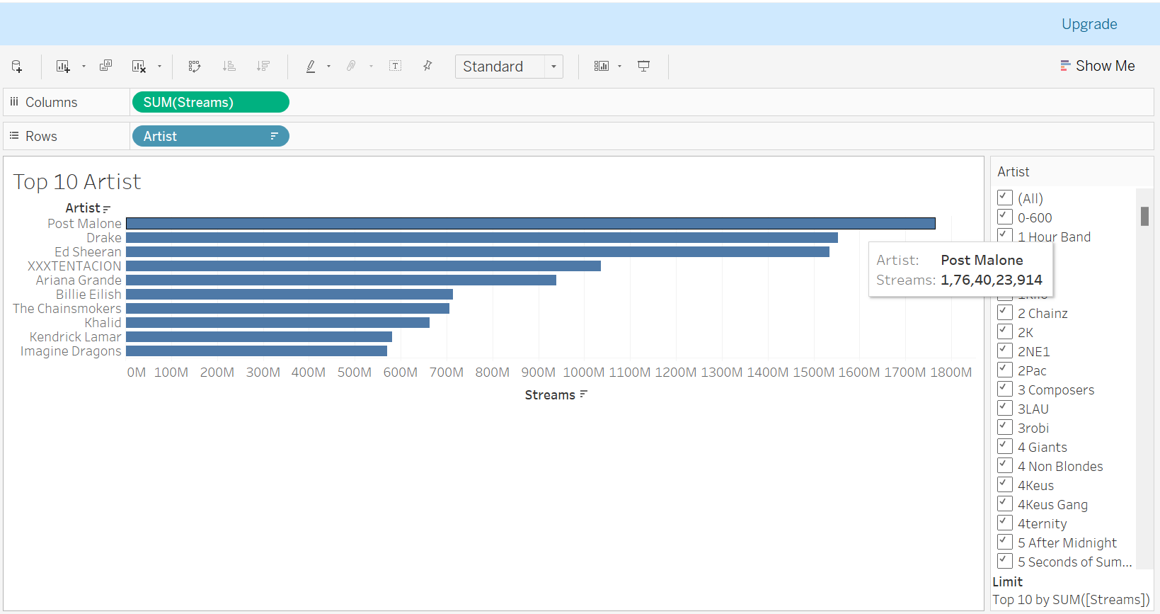
TOP 10 ARTISTS
TOP 10 ARTISTS WITH STREAMS

Slide 20
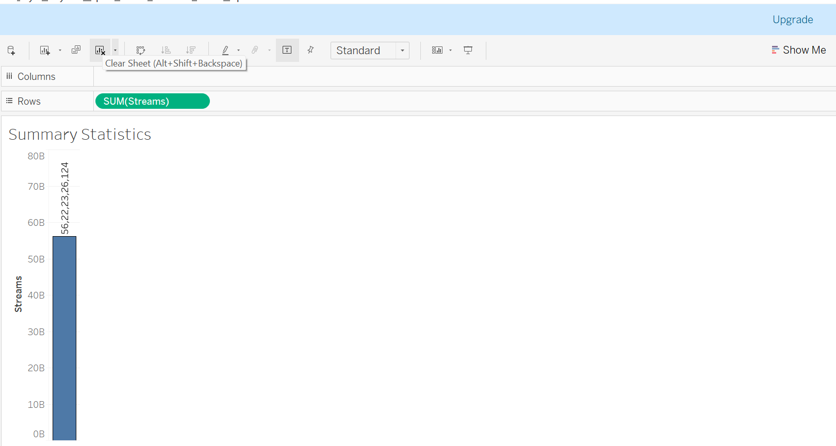
EDA - SUM
Exploratory Data Analysis – all summary
Statistical visuals
In this visual, the sum of streams and it
Shows 56.22 Billion streams

Slide 21
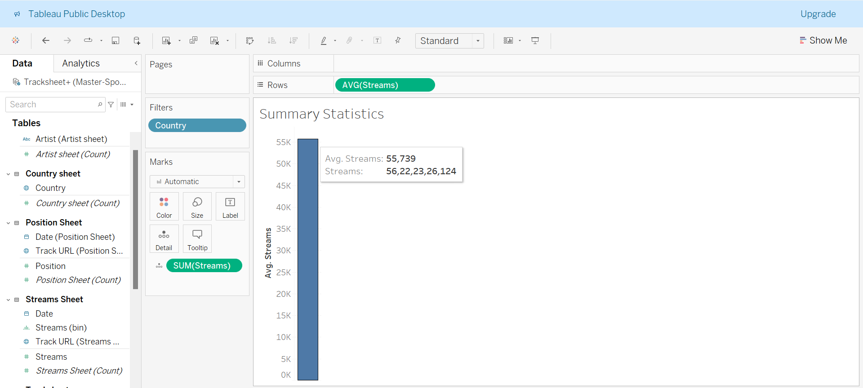
EDA - AVG
Average

Slide 22
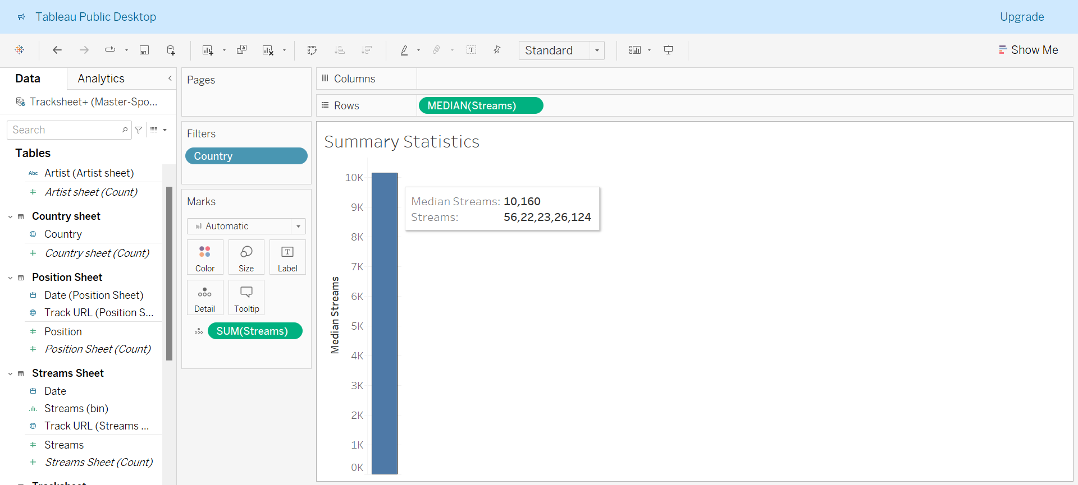
EDA - MEDIAN
Median

Slide 23
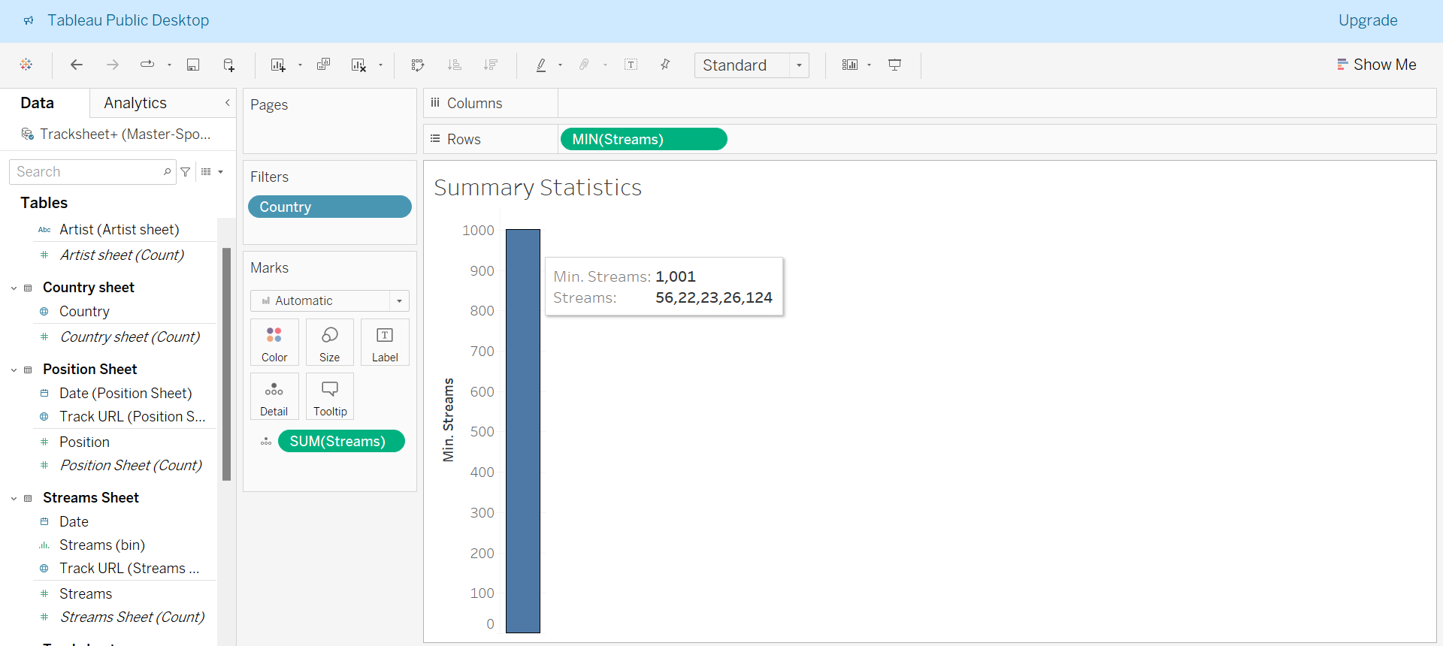
EDA - MIN
MIN

Slide 24
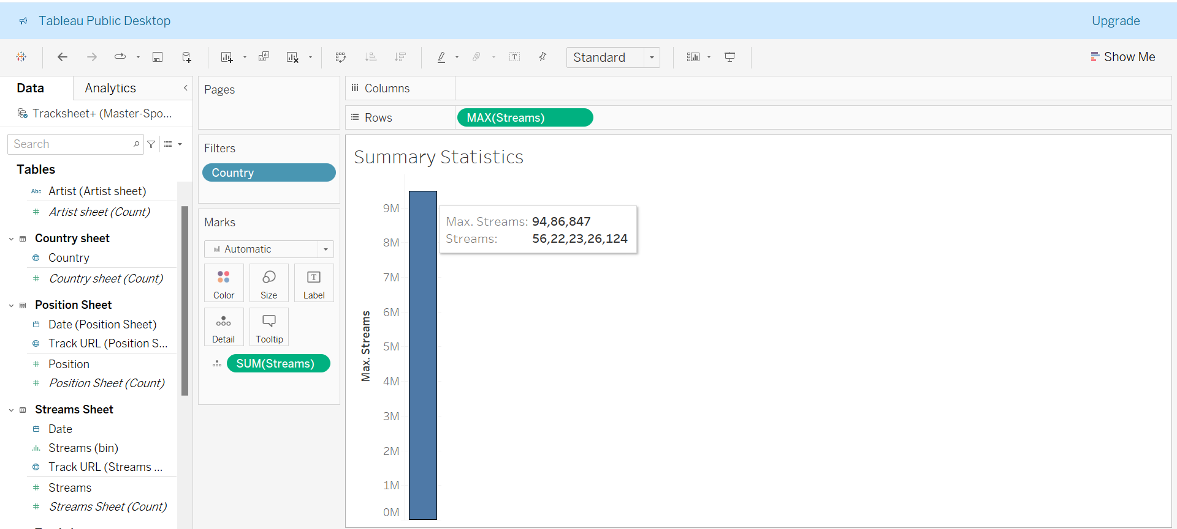
EDA - MAX
MAX

Slide 25
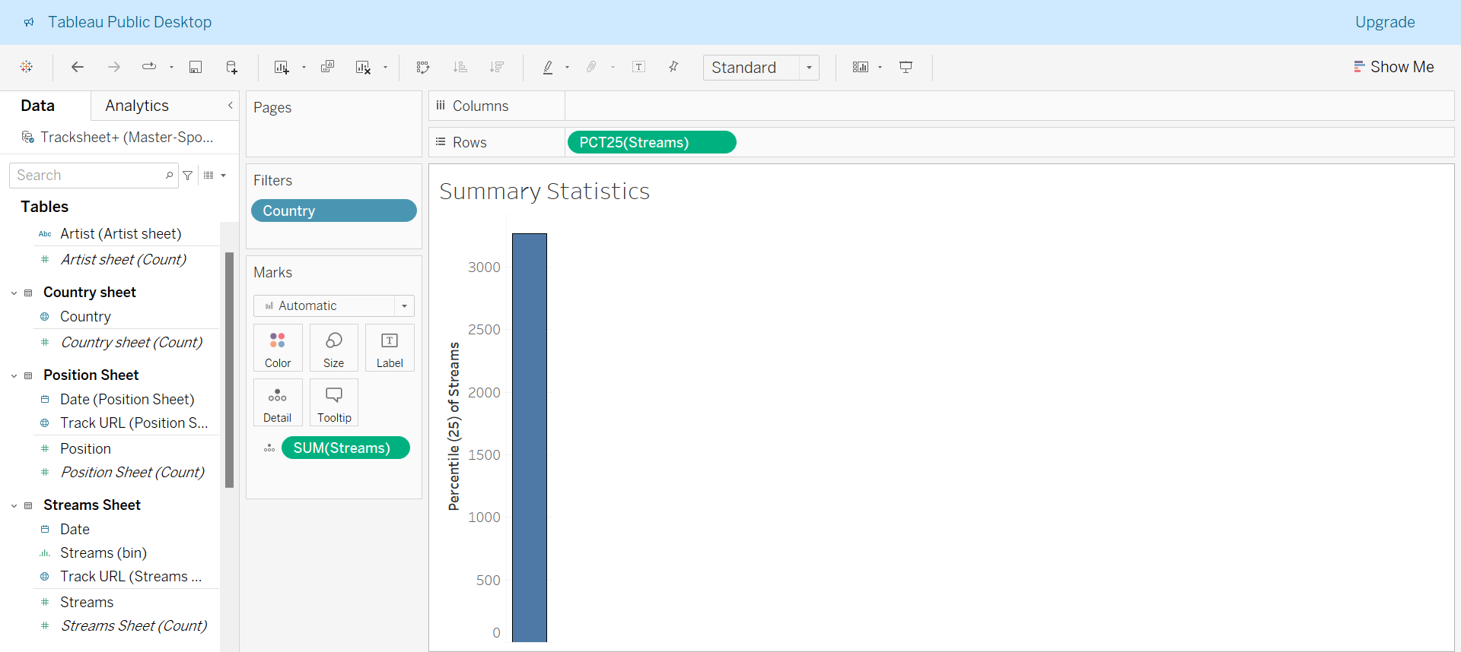
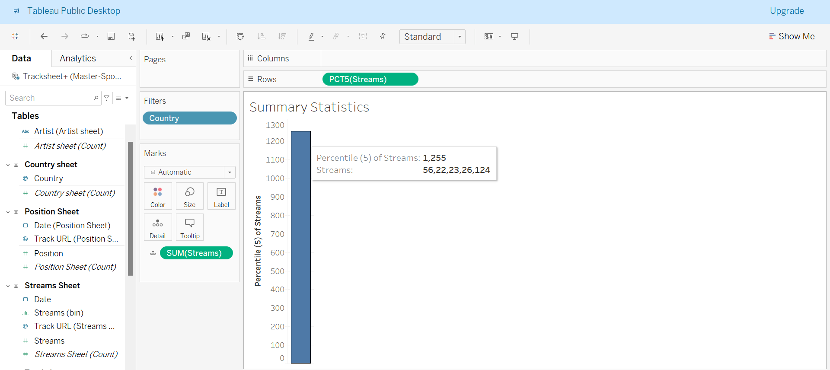
EDA - Percentile
Percentile - 25
Percentile - 5

Slide 26
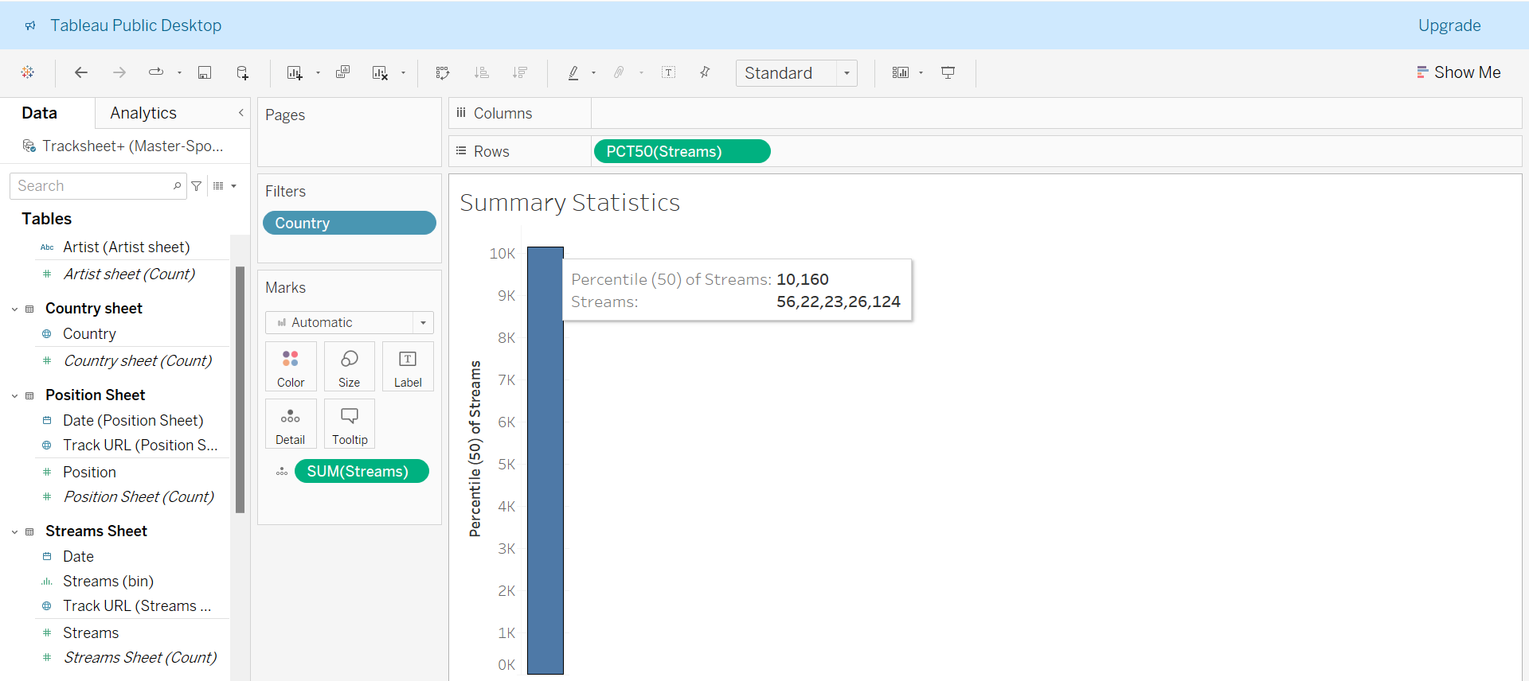
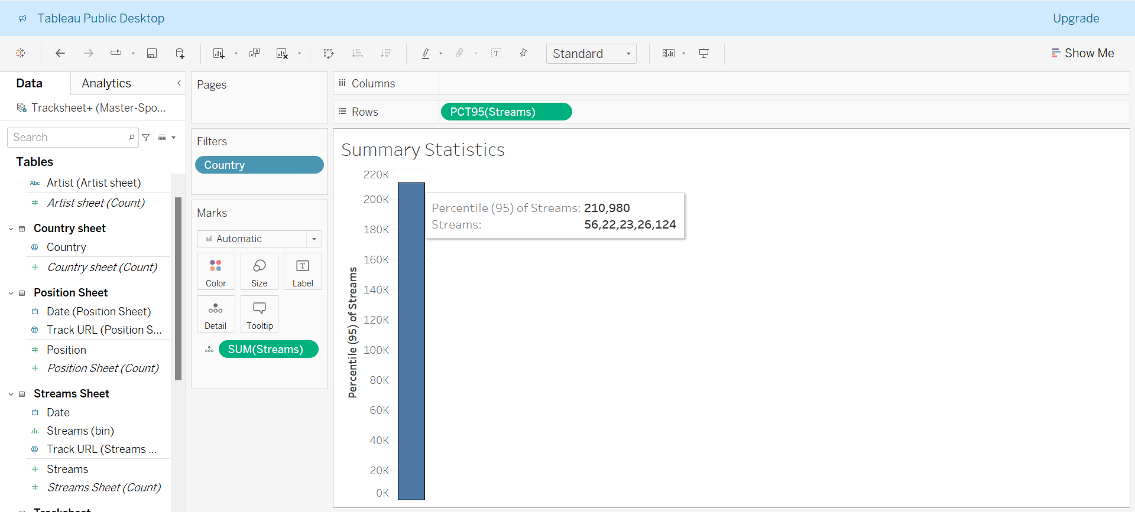
EDA - Percentile
Percentile - 95
Percentile - 50

Slide 27
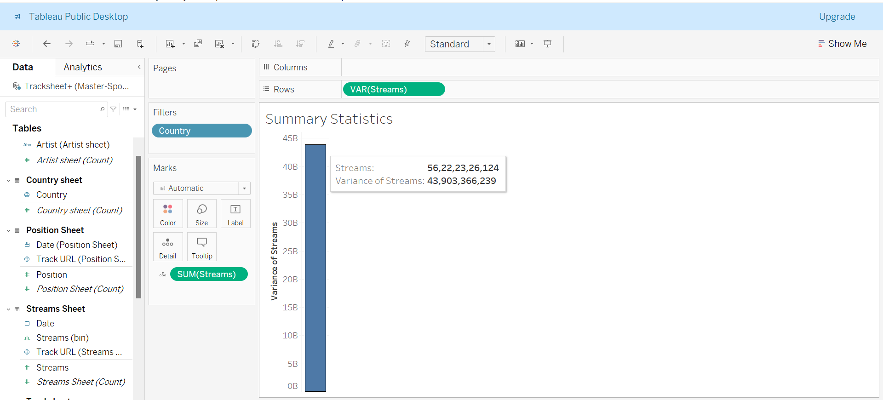
EDA - Variance
Variance

Slide 28
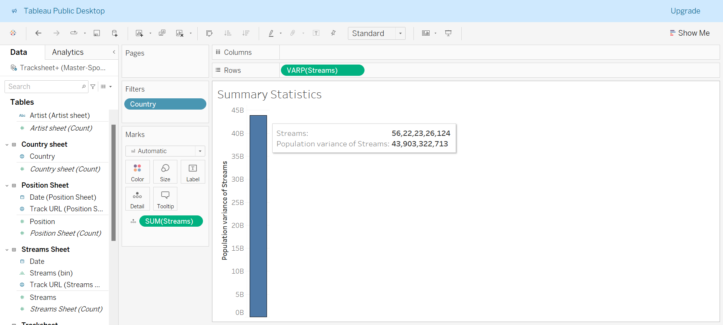
EDA – Variance Pop
Variance

Slide 29
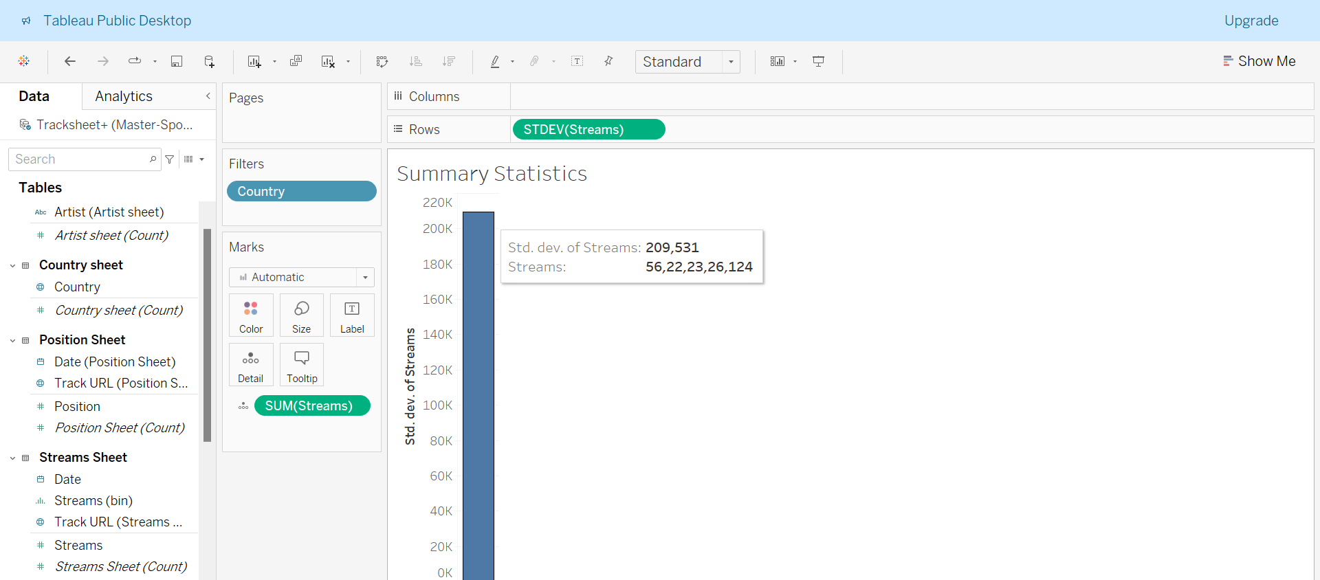
EDA – SD Dev
SD Dev

Slide 30
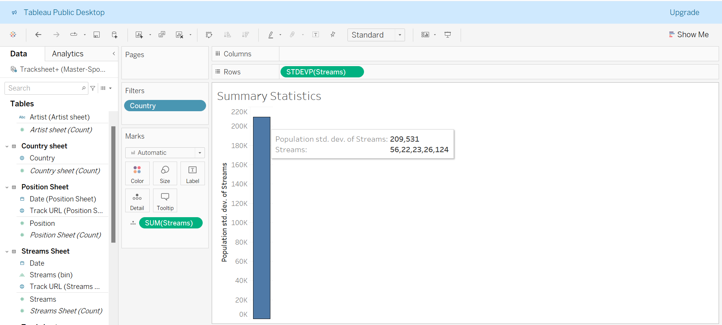
EDA – SD Dev Pop
SD Dev Pop

Slide 31
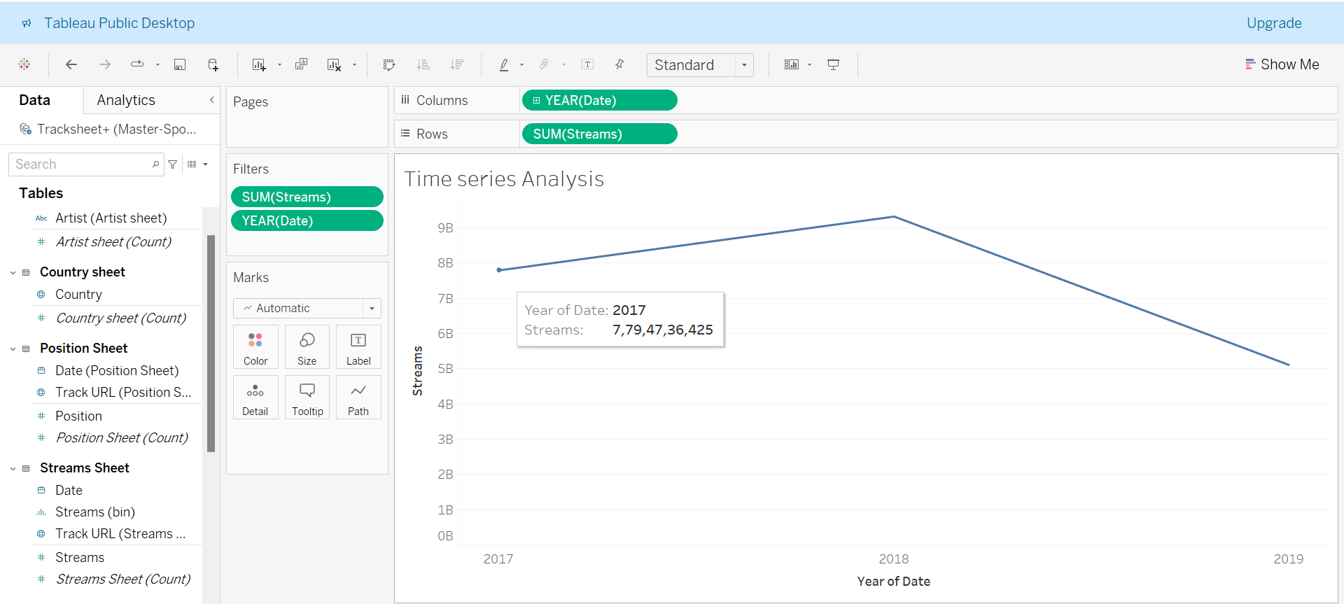
Time Series Analysis
Time Series Analysis

Slide 32
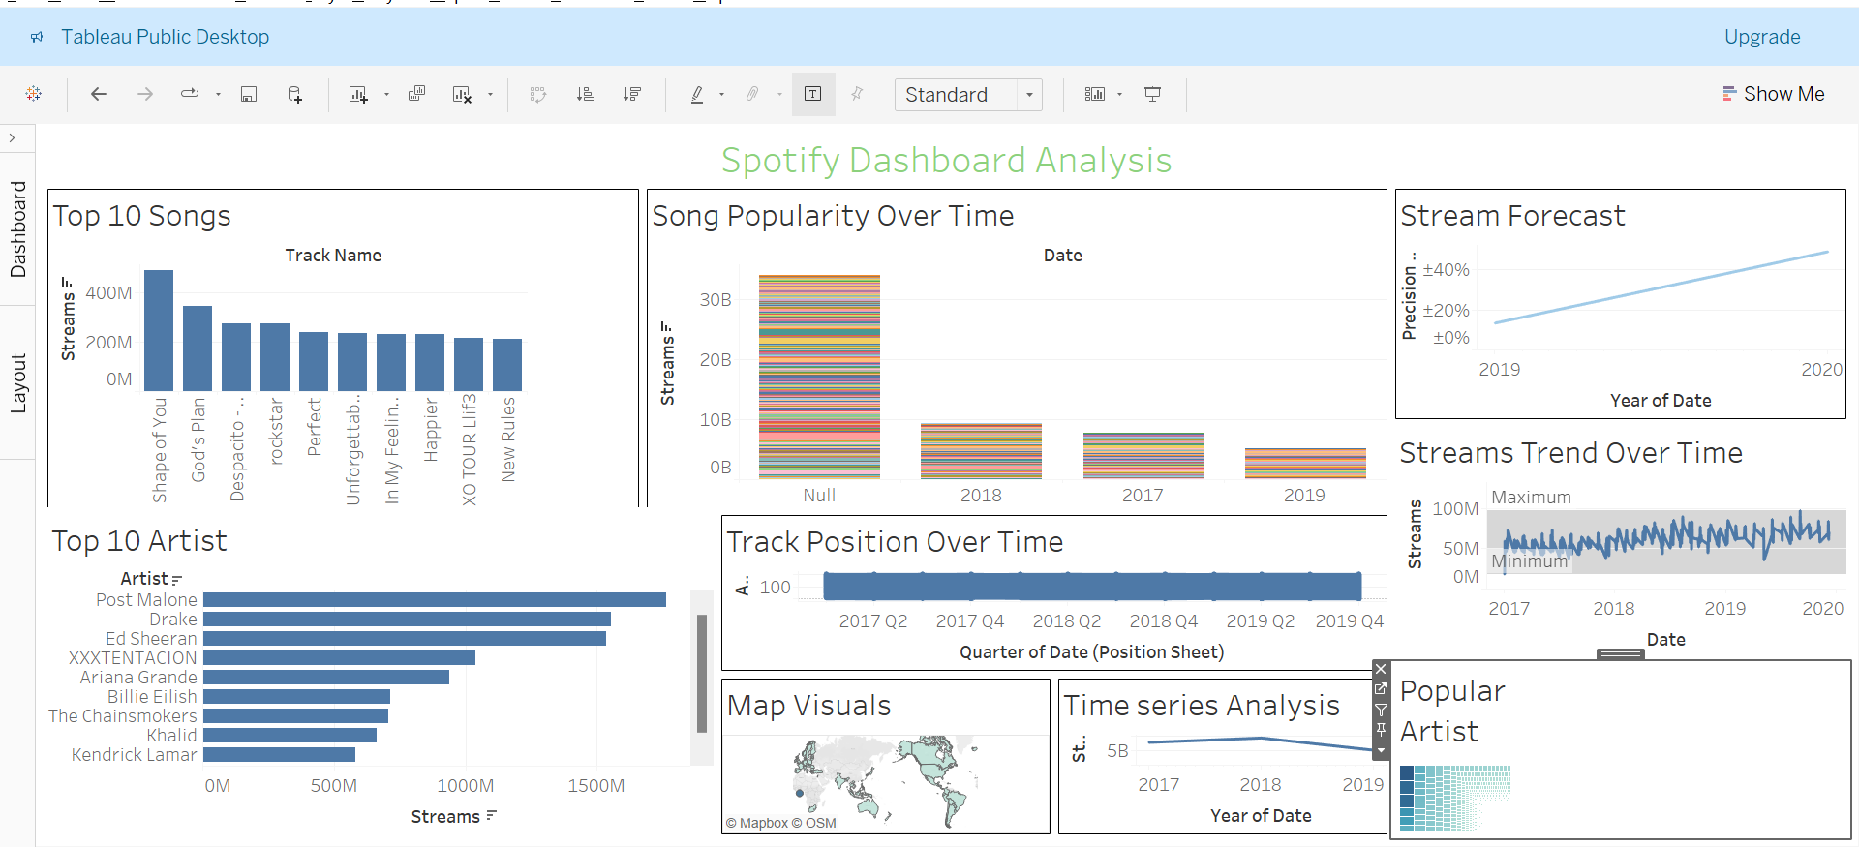
Dashboard
Dashboard

Slide 33

Summary
Data Cleaning and Preparation
Downloaded the raw Spotify data in CSV format and converted it to an Excel file.
Removed null, duplicate, and blank values to ensure data integrity.
Standardized date formats for consistency.
Structured the data into five sheets: Track Sheet, Artist Sheet, Streams Sheet, Position Sheet, and Country Sheet.
Uploaded the cleaned and organized master dataset into Tableau and created relationships between the sheets for comprehensive analysis.

Slide 34
Summary
The objective of this project is to utilize Tableau's data visualization capabilities to analyze and present insights from Spotify data. By transforming raw data into interactive visualizations, this project aims to enable users to gain insights, make data-driven decisions, and explore their music preferences in a visually engaging manner. As an analyst, recommendations will be provided to suggest advertisements to stay competitive in the music industry.

Slide 35

Key Visualizations
Top Tracks
Streams Forecast
Bar Chart: Displays the top 10 tracks by their total streams.
Filters: Year, artist, and country filters added for interactive exploration.
Insights: Identifies the most popular tracks and trending artists.
Line Chart: Forecasted streams based on historical data.
Precision Gauge: Indicates the accuracy of the forecast model.
Insights: Provides predictions for future trends, aiding in strategic planning and resource allocation.
Streams Trends
Popular Artists
Line Chart: Shows the trend of song streams over time.
Colors: Different colors represent different tracks, artists, or genres.
Insights: Highlights seasonal peaks, long-term growth or decline, and helps in understanding listener behavior over time.
Bar Chart: Displays the top artists by popularity metrics such as total streams or popularity score.
Filters: Year, country, and genre filters for dynamic exploration.
Insights: Recognizes top performers and market trends, aiding in strategic marketing and promotional efforts.

Slide 36
Key Matrix Visuals
Top 10 Songs
Visualization: Bar Chart
Description:
The bar chart displays the top 10 songs based on their total streams.
Each bar represents a song, with the length corresponding to the number of streams.
The x-axis shows the song titles, and the y-axis shows the stream counts.
Bars are sorted in descending order, with the most streamed song at the top.
Insights:
Identifies the most popular songs.
Highlights songs that have garnered significant listener attention.
Steps in Tableau:
Drag 'Track Name' to Columns.
Drag 'Streams' to Rows.
Sort the bars in descending order by streams.
Filter the top 10 songs.

Slide 37
Key Matrix Visuals
Top 10 Artists
Visualization: Bar Chart
Description:
The bar chart displays the top 10 artists based on their total streams.
Each bar represents an artist, with the length corresponding to the number of streams.
The x-axis shows the artist names, and the y-axis shows the stream counts.
Bars are sorted in descending order, with the most streamed artist at the top.
Insights:
Identifies the most popular artists.
Highlights artists who are currently trending.
Steps in Tableau:
Drag 'Artist Name' to Columns.
Drag 'Streams' to Rows.
Sort the bars in descending order by streams.
Filter the top 10 artists.

Slide 38
Key Matrix Visuals
Summary Statistics of Spotify Streams
Introduction: Provide a brief description of what the summary statistics represent and how they offer a snapshot of the dataset.
Key Insights: Highlight key points such as the average number of streams, the variability in streaming numbers, and the range between minimum and maximum streams.
By following these steps, you can create a detailed and informative summary statistics table in Tableau that provides essential insights into the distribution and variability of streaming data, complementing your other visuals in the dashboard.

Slide 39
Key Matrix Visuals
This dashboard combines multiple interactive visuals to provide a holistic view of the Spotify data.
It includes top 10 songs, top 10 artists, and summary statistics to give insights into popular tracks, influential artists, and key streaming metrics.

Slide 40
Recommendations
1. Targeted Advertising Campaigns
Utilize User Demographics: Leverage insights on user demographics (e.g., age, gender, location) to create targeted advertising campaigns that resonate with specific audience segments.
Focus on Popular Tracks and Artists: Promote the top 10 songs and top 10 artists identified in the analysis to maximize engagement and reach. These tracks and artists have already demonstrated significant listener interest.
Seasonal and Event-Based Promotions: Utilize the streams trend over time visual to identify seasonal peaks and plan advertising campaigns around these periods. Promote music during high-traffic times like holidays and major events.

Slide 41
Recommendations
2. Personalized Marketing
User Preferences: Use data on individual user preferences and listening habits to personalize marketing messages. Recommend tracks, playlists, and artists that align with their tastes.
Customized Playlists: Create and promote customized playlists based on user preferences, listening history, and trending tracks.

Slide 42
Recommendations
3. Strategic Collaborations
Identify Emerging Artists: Use the popular artists visual to identify not only top-performing artists but also emerging ones who are gaining traction. Collaborate with these artists for promotions and exclusive content.
Cross-Genre Collaborations: Explore opportunities for cross-genre collaborations to attract a diverse audience and create unique content that stands out.

Slide 43
Recommendations
4. Content Diversification
Expand Genre Offerings: Analyze the data to identify popular and trending genres. Expand content offerings in these genres to cater to user preferences.
Exclusive Releases: Provide exclusive releases or early access to new tracks for subscribers to increase engagement and retain users.

Slide 44
Recommendations
5. Trend Analysis and Predictive Insights
Monitor Trends: Continuously monitor streams trend over time to stay ahead of industry shifts. Use these insights to adjust marketing strategies and content offerings.
Forecast Future Trends: Utilize the streams forecast visual to predict future trends in music consumption. Plan marketing and content strategies based on these forecasts to stay proactive and competitive

Slide 45
Recommendations
6. Enhance User Engagement
Interactive Features: Add interactive features to the platform, such as user polls, ratings, and comments, to enhance engagement and gather real-time feedback.
Live Events and Virtual Concerts: Host live events and virtual concerts featuring popular artists to drive user engagement and increase platform usage.

Slide 46
Recommendations
7. Data-Driven Decision Making
Regular Analysis: Regularly update and analyze the dashboard to keep track of new trends and changes in user behavior. Use these insights to make informed decisions about marketing strategies and content curation.
A/B Testing: Implement A/B testing for different marketing campaigns and content strategies to identify what works best and optimize accordingly.

Slide 47
Conclusion
By implementing these recommendations, Spotify can leverage the insights gained from Tableau's visualizations to enhance user experience, increase engagement, and drive growth. Targeted advertising, personalized marketing, strategic collaborations, and continuous trend analysis will help Spotify stay competitive in the dynamic music industry

Slide 48



THANK YOU!

